Slide 1
Non-Parametric Test
Md. Aminul Hoque, PhD

Slide 2
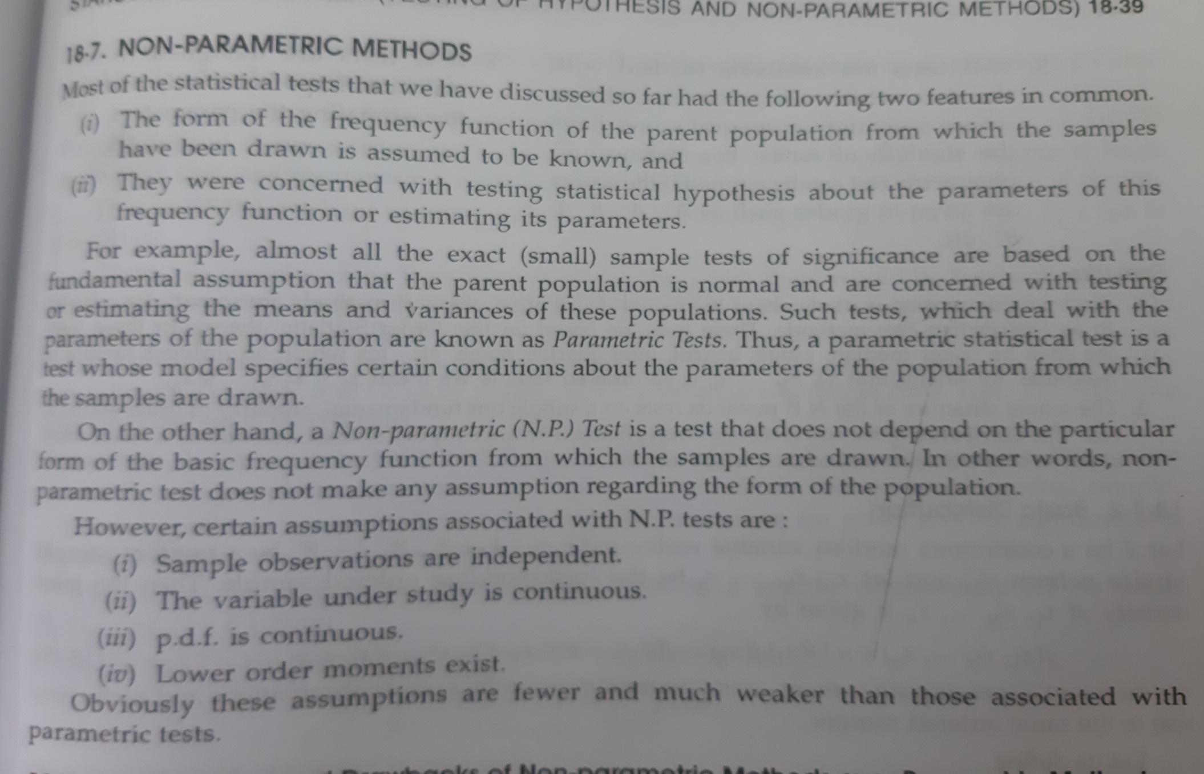
Non-Parametric Method

Slide 3
Definition
Nonparametric statistics is the branch of statistics that is not based solely on parametrized families of probability distributions. Nonparametric statistics is based on either being distribution-free or having a specified distribution but with the distribution's parameters unspecified.

Slide 4
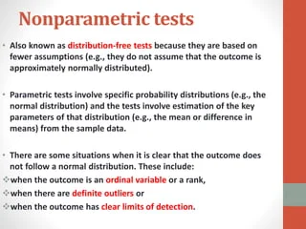
Non-Parametric Test

Slide 5
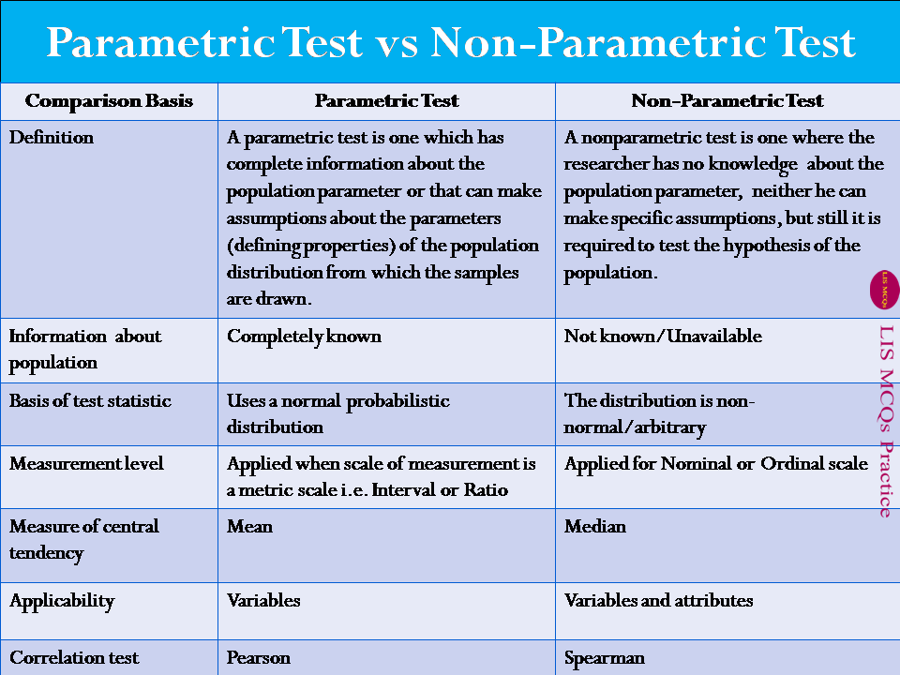

Slide 6
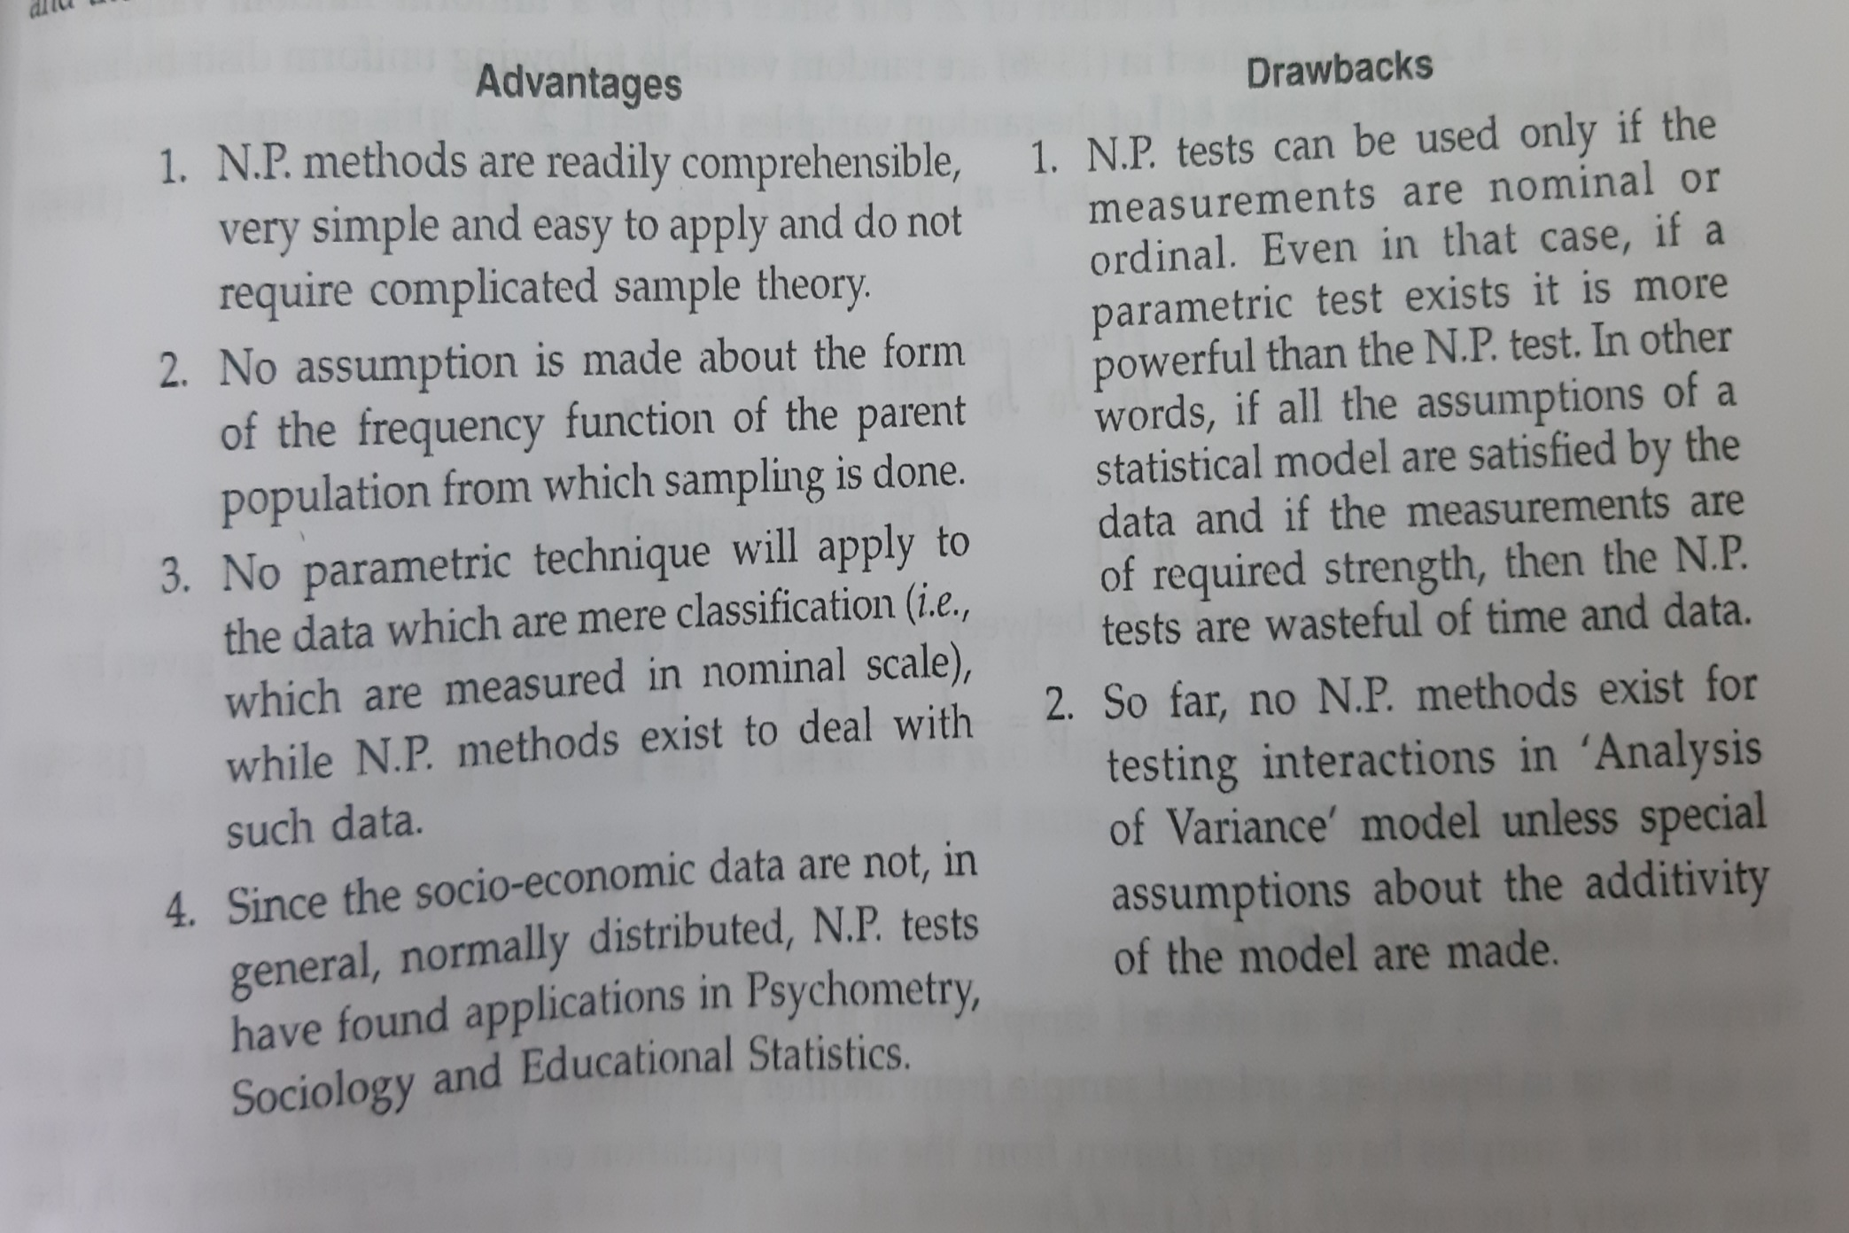
Advantages and Disadvantages

Slide 7
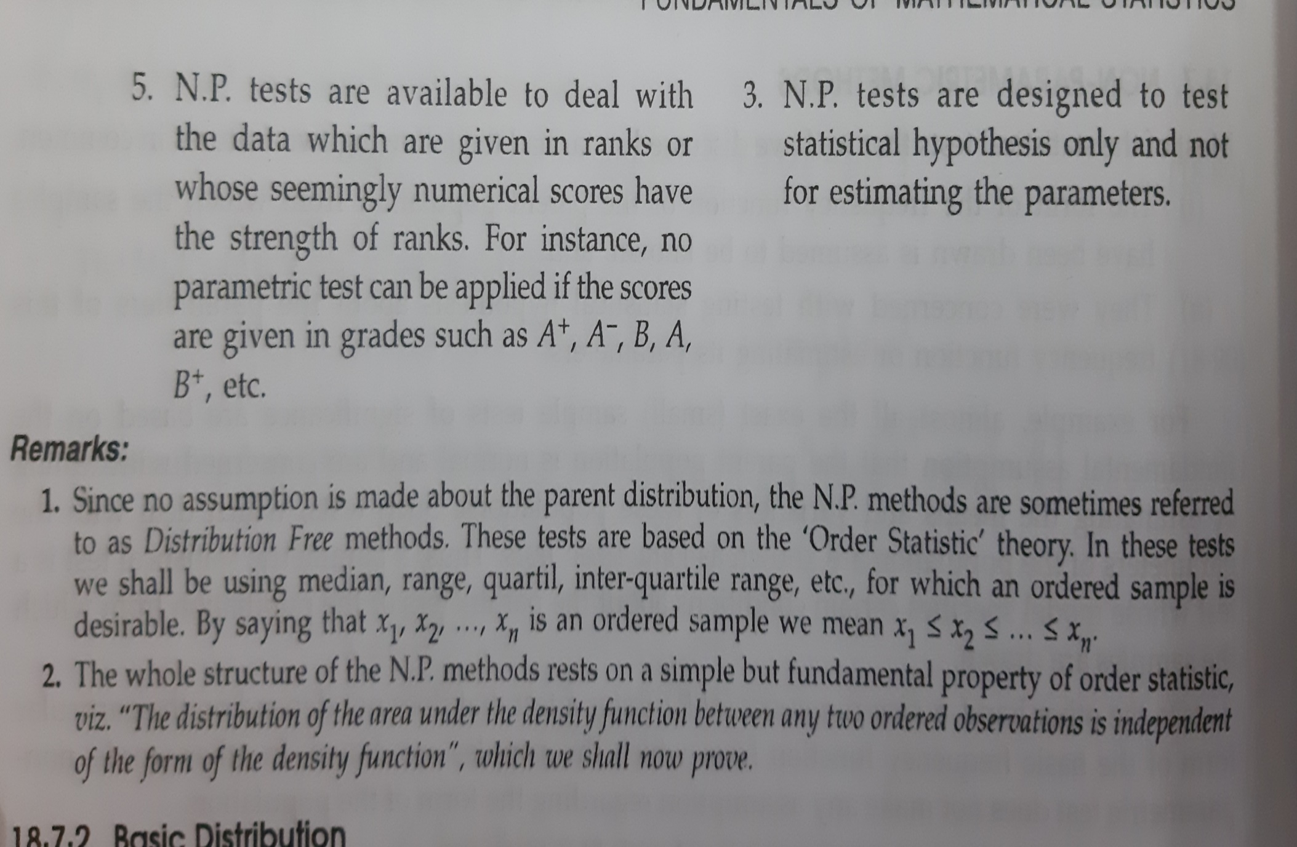
Cont…

Slide 8
Non-Parametric Methods
Rank Test
Randomness Test
Run Test
Sign Test
Median Test
Mann-Whitney-Wilcoxon U-Test
Kruskall-Walis Test
Wilcoxon Signed-rank Test

Slide 9
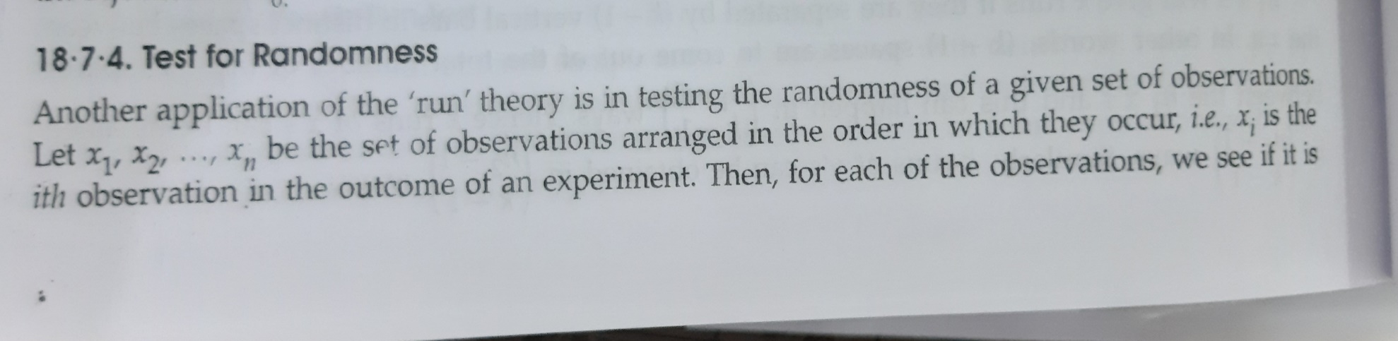
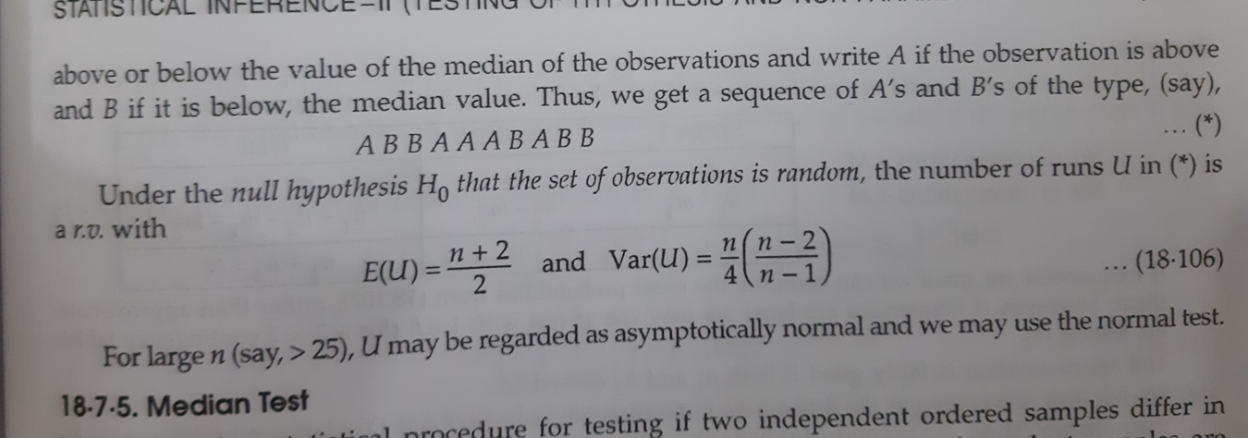
Randomness Test

Slide 10
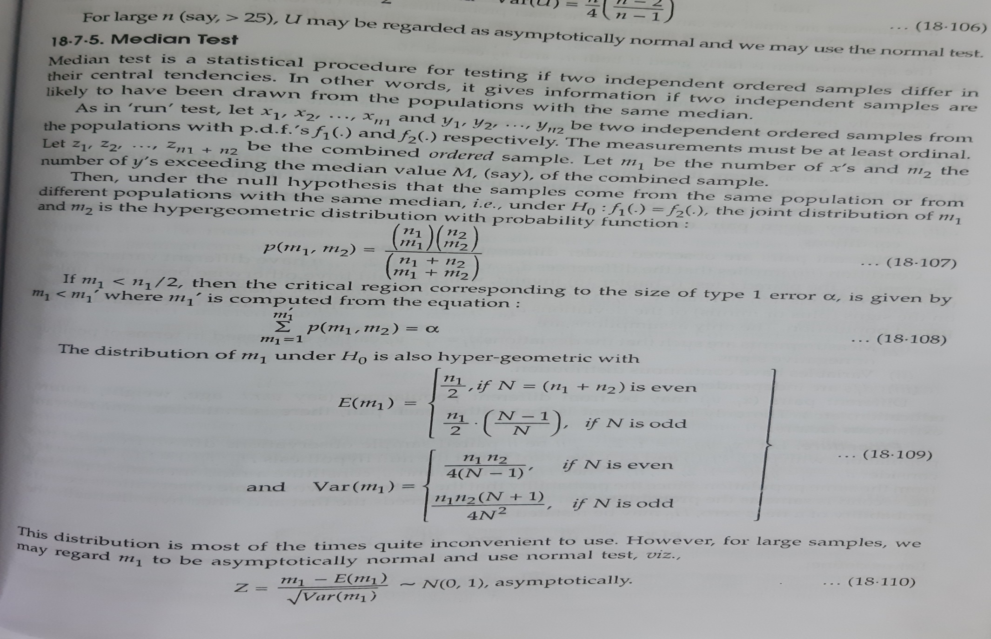
Median Test

Slide 11
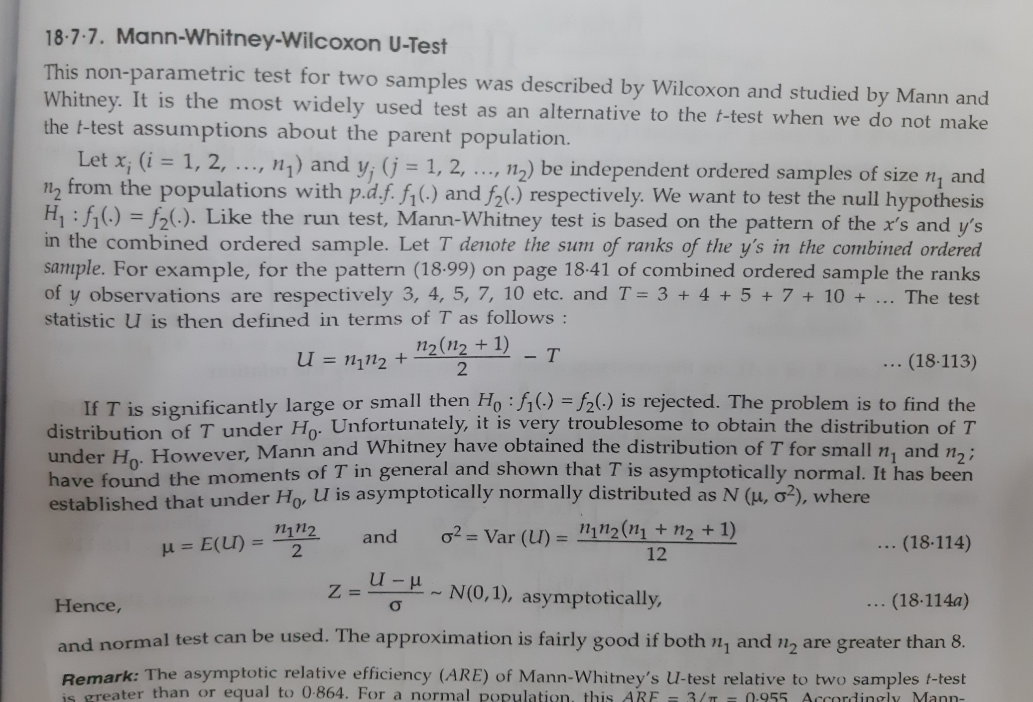
Mann-Whitney-Wilcoxon test

Slide 12
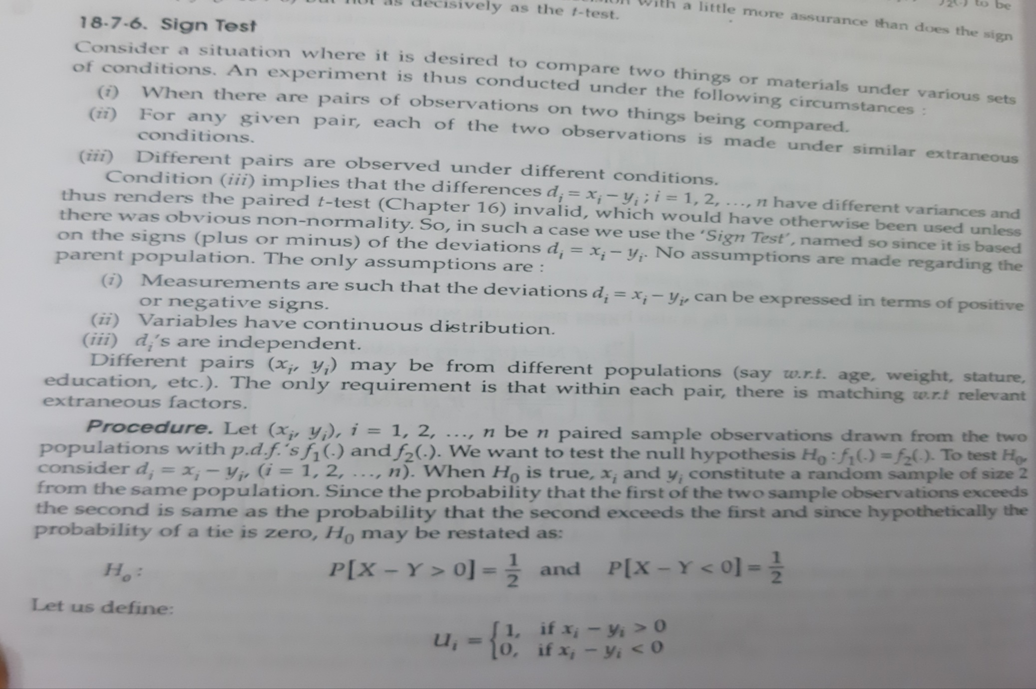
Sign Test

Slide 13
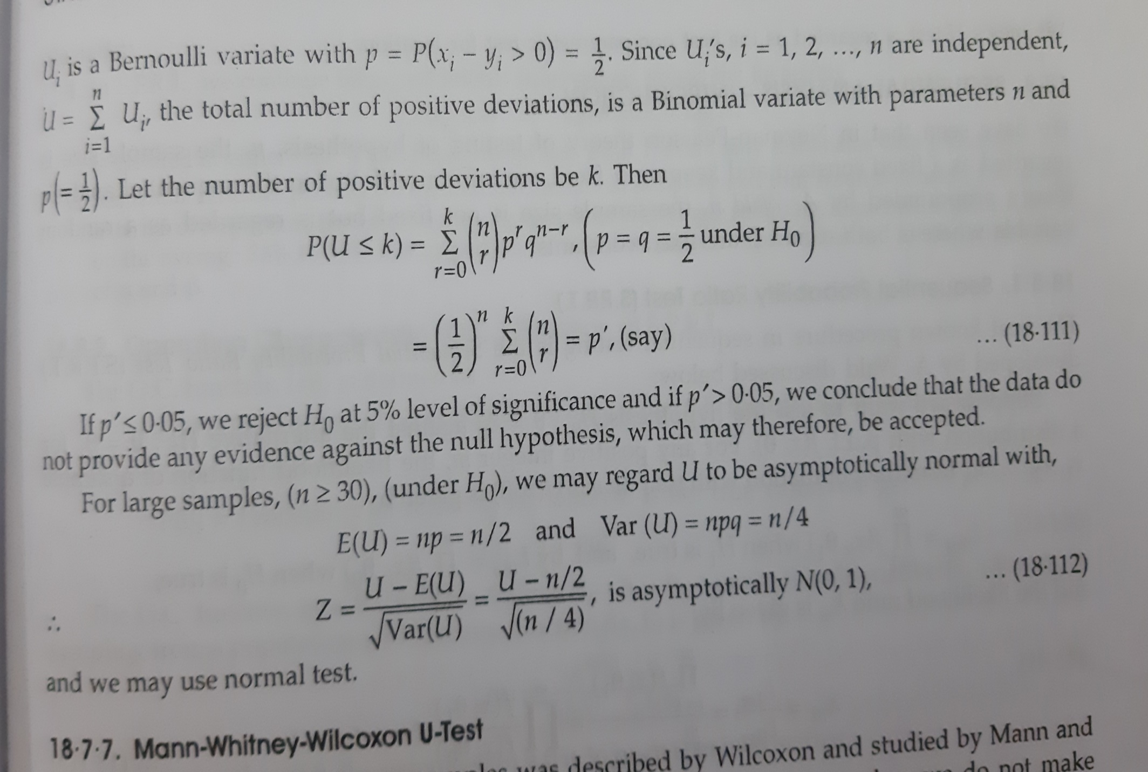
Cont…

Slide 14
https://www.statisticssolutions.com/free-resources/directory-of-statistical-analyses/sign-test/

Slide 15
Sign Test
The Sign test is a non-parametric test that is used to test whether or not two groups are equally sized. The sign test is used when dependent samples are ordered in pairs, where the bivariate random variables are mutually independent It is based on the direction of the plus and minus sign of the observation, and not on their numerical magnitude. It is also called the binominal sign test, with p = .5.. The sign test is considered a weaker test, because it tests the pair value below or above the median and it does not measure the pair difference. The sign test is available in SPSS: click “menu,” select “analysis,” then click on “nonparametric,” and choose “two related sample” and “sign test.
Questions Answered:
Which product of soda (Pepsi vs. Coke) is preferred among a group of 10 consumers?
Assumptions:
Data distribution: The Sign test is a non–parametric (distribution free) test, so we do not assume that the data is normally distributed.
Two sample: Data should be from two samples. The population may differ for the two samples.
Dependent sample: Dependent samples should be a paired sample or matched. Also known as ‘before–after’ sample.

Slide 16
Types of sign test:
One sample: We set up the hypothesis so that + and – signs are the values of random variables having equal size.
Paired sample: This test is also called an alternative to the paired t-test. This test uses the + and – signs in paired sample tests or in before-after study. In this test,
null hypothesis is set up so that the sign of + and – are of equal size, or the population means are equal to the sample mean.

Slide 17
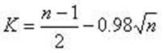
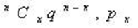
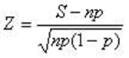

Procedure:
Calculate the + and – sign for the given distribution.
Put a + sign for a value greater than the mean value, and put a – sign
for a value less than the mean value. Put 0 as the value is
equal to the mean value; pairs with 0 as the mean value are considered ties.
Denote the total number of signs by ‘n’ (ignore the zero sign)
and the number of less frequent signs by ‘S.’
Obtain the critical value (K) at .05 of the significance level
by using the following formula in case of small samples:
Sign test in case of large sample:
For Binomial distribution the formula may be
^{n}$C_{x}p^{x}q^{n−x}$ with p=0.5

Slide 18
Compare the value of ‘S’ with the critical value (K). If the value of S is greater than the value of K, then the null hypothesis is accepted.
If the value of the S is less than the critical value of K, then the null hypothesis is accepted. In the case of large samples, S is compared with the Z value.

Slide 19
The Wilcoxon signed-rank test is a non-parametric statistical hypothesis test used either to test the location of a population based on a sample of data, or to compare the locations of two populations using two matched samples.^{[1]} The one-sample version serves a purpose similar to that of the one-sample Student's t-test.^{[2]} For two matched samples, it is a paired difference test like the paired Student's t-test (also known as the "t-test for matched pairs" or "t-test for dependent samples"). The Wilcoxon test can be a good alternative to the t-test when population means are not of interest; for example, when one wishes to test whether a population's median is nonzero, or whether there is a better than 50% chance that a sample from one population is greater than a sample from another population.

Slide 20
https://en.wikipedia.org/wiki/Wilcoxon_signed-rank_test

